Slide 1
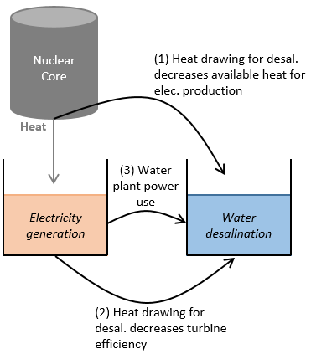
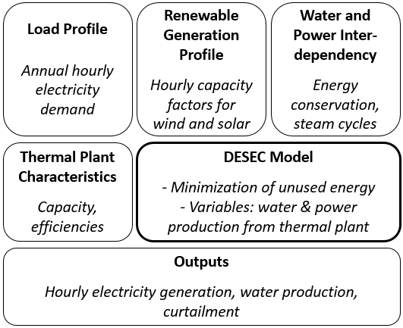
Operational Viability of a Renewable-Nuclear Mix:
Optimizing Electricity Production and Water Desalination Simultaneously
Anne-Perrine Avrin & Professor Daniel M. Kammen
Renewable and Appropriate Energy Laboratory
Energy and Resources Group
University of California, Berkeley
Context
Model
Case Study: Shandong Province
1.6 billion people experience water scarcity globally
Climate change, population growth and income growth increase water stress
Water crises threaten economic growth and social stability
In Asia and the Middle-East, populated coastal areas experience both water stress and air pollution
Large-scale deployment of variable renewable energies to reduce air pollution calls for new paradigms to maintain a reliable power grid
Heat from thermal reactors, such as nuclear, can be used to produce purified water (drinking/industrial standards) through desalination
Because the nuclear core power is fixed, water and electricity production are competing processes
It is possible to dynamically balance out power generation and desalination as a function of instantaneous needs, spot prices, etc.
Water storage in large reservoirs is not technically challenging
Integrating desalination with power generation can be seen as a mean to store energy in excess (by storing fresh water instead of storing electricity)
WHAT WOULD AN OPTIMAL 100% SOLAR PV-NUCLEAR WATER-POWER MIX IN SHANDONG LOOK LIKE?
DESEC Model
Simulates hourly operation of 100% Renewable/Nuclear mix
Minimizes power system curtailment (i.e. max. use of energy)
by optimizing electricity & fresh water production from thermal reactors
Thermodynamic cycle modeling
Inter-dependence of electricity generation and water desalination: 3 competing processes
Shandong is a proxy for populated coastal areas simultaneously experiencing water shortage, air pollution, and high power needs
Annual water shortage in Shandong is 4-5 billion m³
Current installed power capacity: 86 GW
Shandong is transitioning to renewable and nuclear generation systems
Current Electricity Mix (Inst. Cap.)
Structure of the DESEC Model
DESEC Model analysis
Hourly solar PV capacity factors from y. 2015 (average: 96 MWh/h)
Hourly load from y. 2015, time-synchronized with solar (average: 17%)
Nuclear technology: Hualong One
Desalination technology characteristics from IAEA’s DEEP tool
Power mix: 100 GW solar PV, 83 GW Nuclear
Simulated Electricity Mix (Inst. Cap.)
Constraints in DESEC
Meeting load and/or water needs
Renewable energy variations
Nuclear reactors’ and desalination systems’ performances & limitations
Results for Case Study
Limitations & Next Steps
By combining power generation and desalination, curtailment in Shandong province becomes virtually non existent: utilization of available energy is maximized
Nuclear becomes a flexible source of electricity. Average hourly electricity variation: 21% of nominal power
Annual fresh water production: 1.4 billion m³, 1/3 of Shandong’s water needs (1% of Lake Tahoe in volume)
Max. daily production in DESEC simulation: 5.8×10⁶ m³ (in April)
DESEC Model can be adapted to meet exactly 100% water needs in each hour (trade-off with electricity needs/curtailment)
Next steps:
Include economic analysis. Preliminary results: desalination is not competitive against simple pumping in water-rich areas, but it is competitive against the South-to-North Water Transfer Project in coastal provinces
Refine thermodynamic cycle modeling in the nuclear reactor
Include water transportation module (GIS feature)
Combine with long-term capacity expansion planning (SWITCH-China)
Limitations of the concept:
Limited to areas near seawater (or with sufficient wastewater)
Limited to areas where nuclear can be deployed
If used with fossil-fuel plants, contributes to polluting emissions
Optimal electricity production and water desalination dispatch over one year for the Shandong Province. Two representative days per month.

